Slide 1
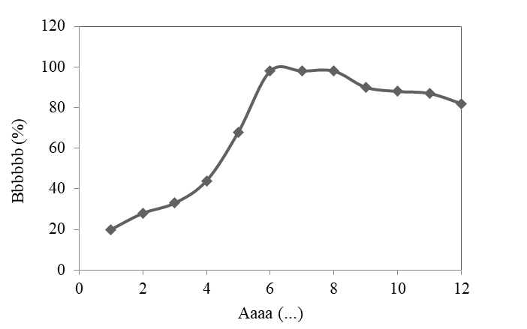
Article Subject (Times New Roman Bold 50)
Author¹, Author², Author³, …
1) University Department, University Name, City, Country, Email
2) Group, Laboratory, City, Country, Email
3) Company Name, City, Country, Email
Abstract
Results and Discussion
The Abstract should be written in Times New Roman font size 30. The abstract should be typed as a single paragraph and 150-250 words.
This should explore the significance of the results of the work
Introduction
In introduction, state the objectives of the work and provide an adequate background, avoiding a detailed literature survey or a summary of the results.
Fig.1. Variation of … during … process
Conclusions
The main conclusions of the study may be presented in a short Conclusions section
Material and methods
Provide sufficient details to allow the work to be reproduced by an independent researcher. Methods that are already published should be summarized, and indicated by a references.
References
List some of the most important references
Article number: …..

